Slide 2

Smart movements- User decision tools
By: ashley guidot, Vishwanath Subramanian, forrest surles, and john weldon

Slide 3

User stories
As a Client I need a quick reference on stock prices prior to make a decision on moving funds between accounts
As a client, I want to know if the current stock prices of ETH & VOO wil continue to follow their current trends
As a financial manager, I want to save time and money by verifying if there is a general correlation between the assets in my portfolio prior to moving funds between accounts

Slide 4
Other user ref
Python code calculates the 50 day moving average & plots against latest stock price trend.
Use code for risk and return measurement, displaying statistics on the Streamlit application before the user executes their decision

Slide 5
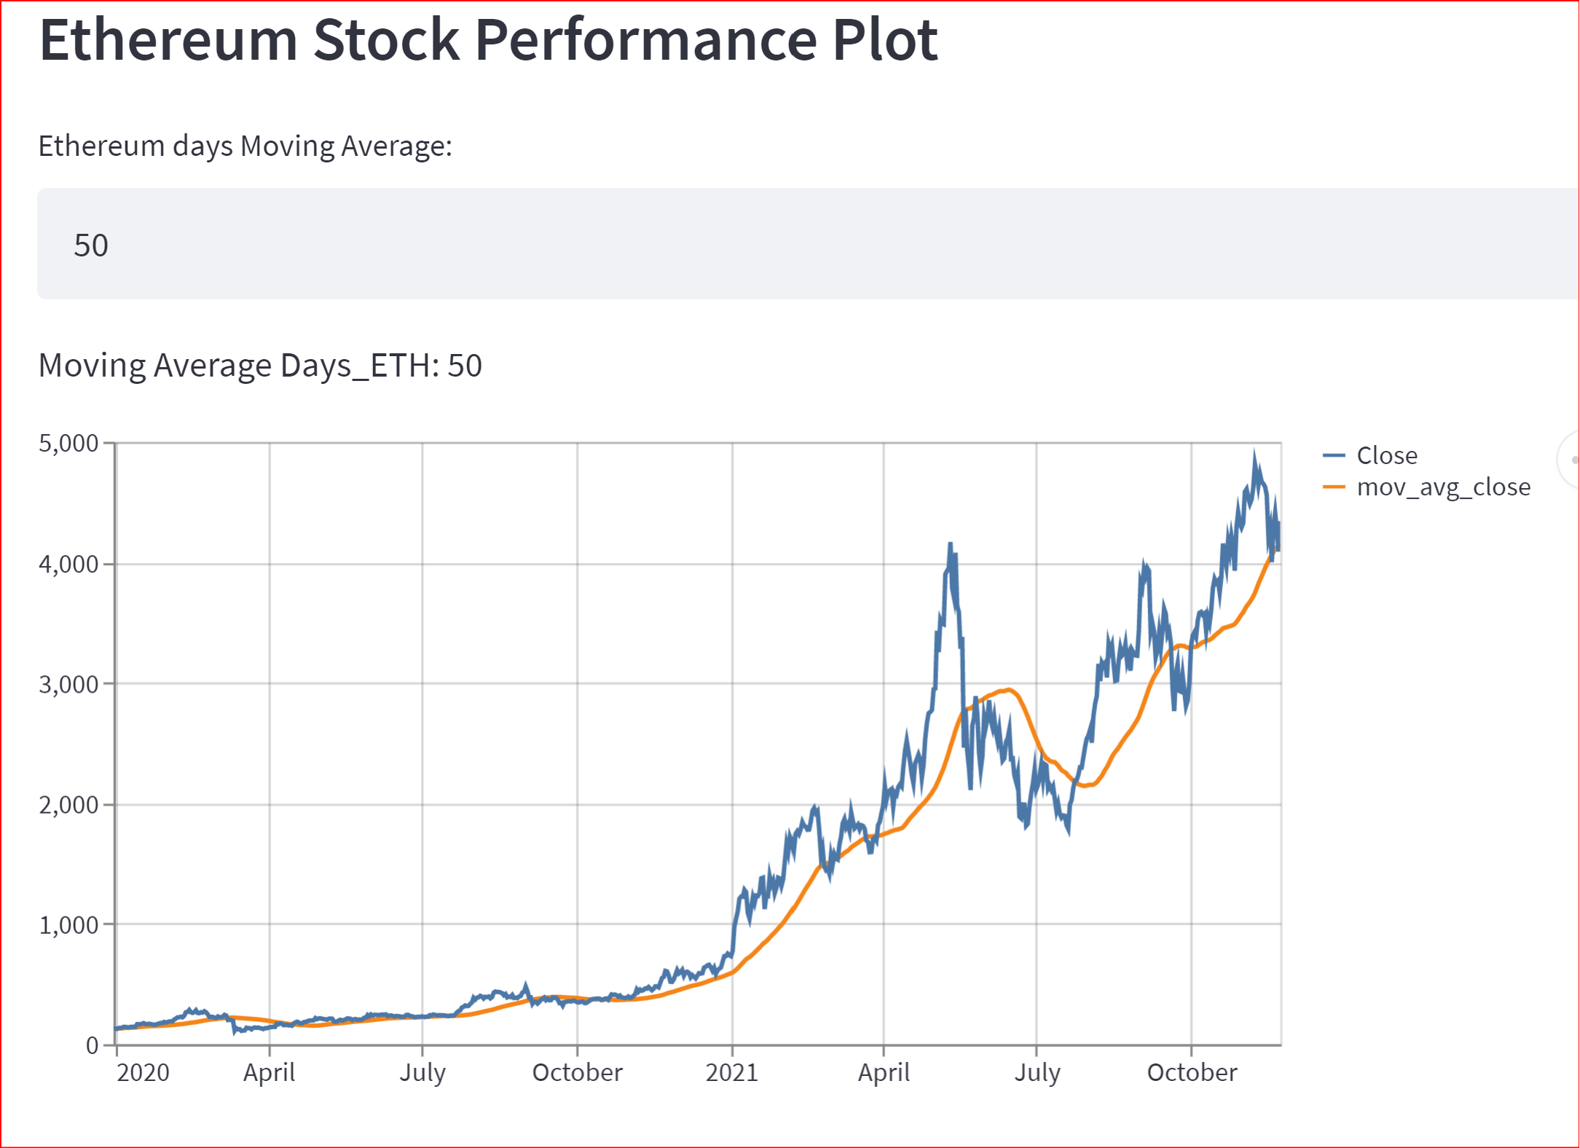
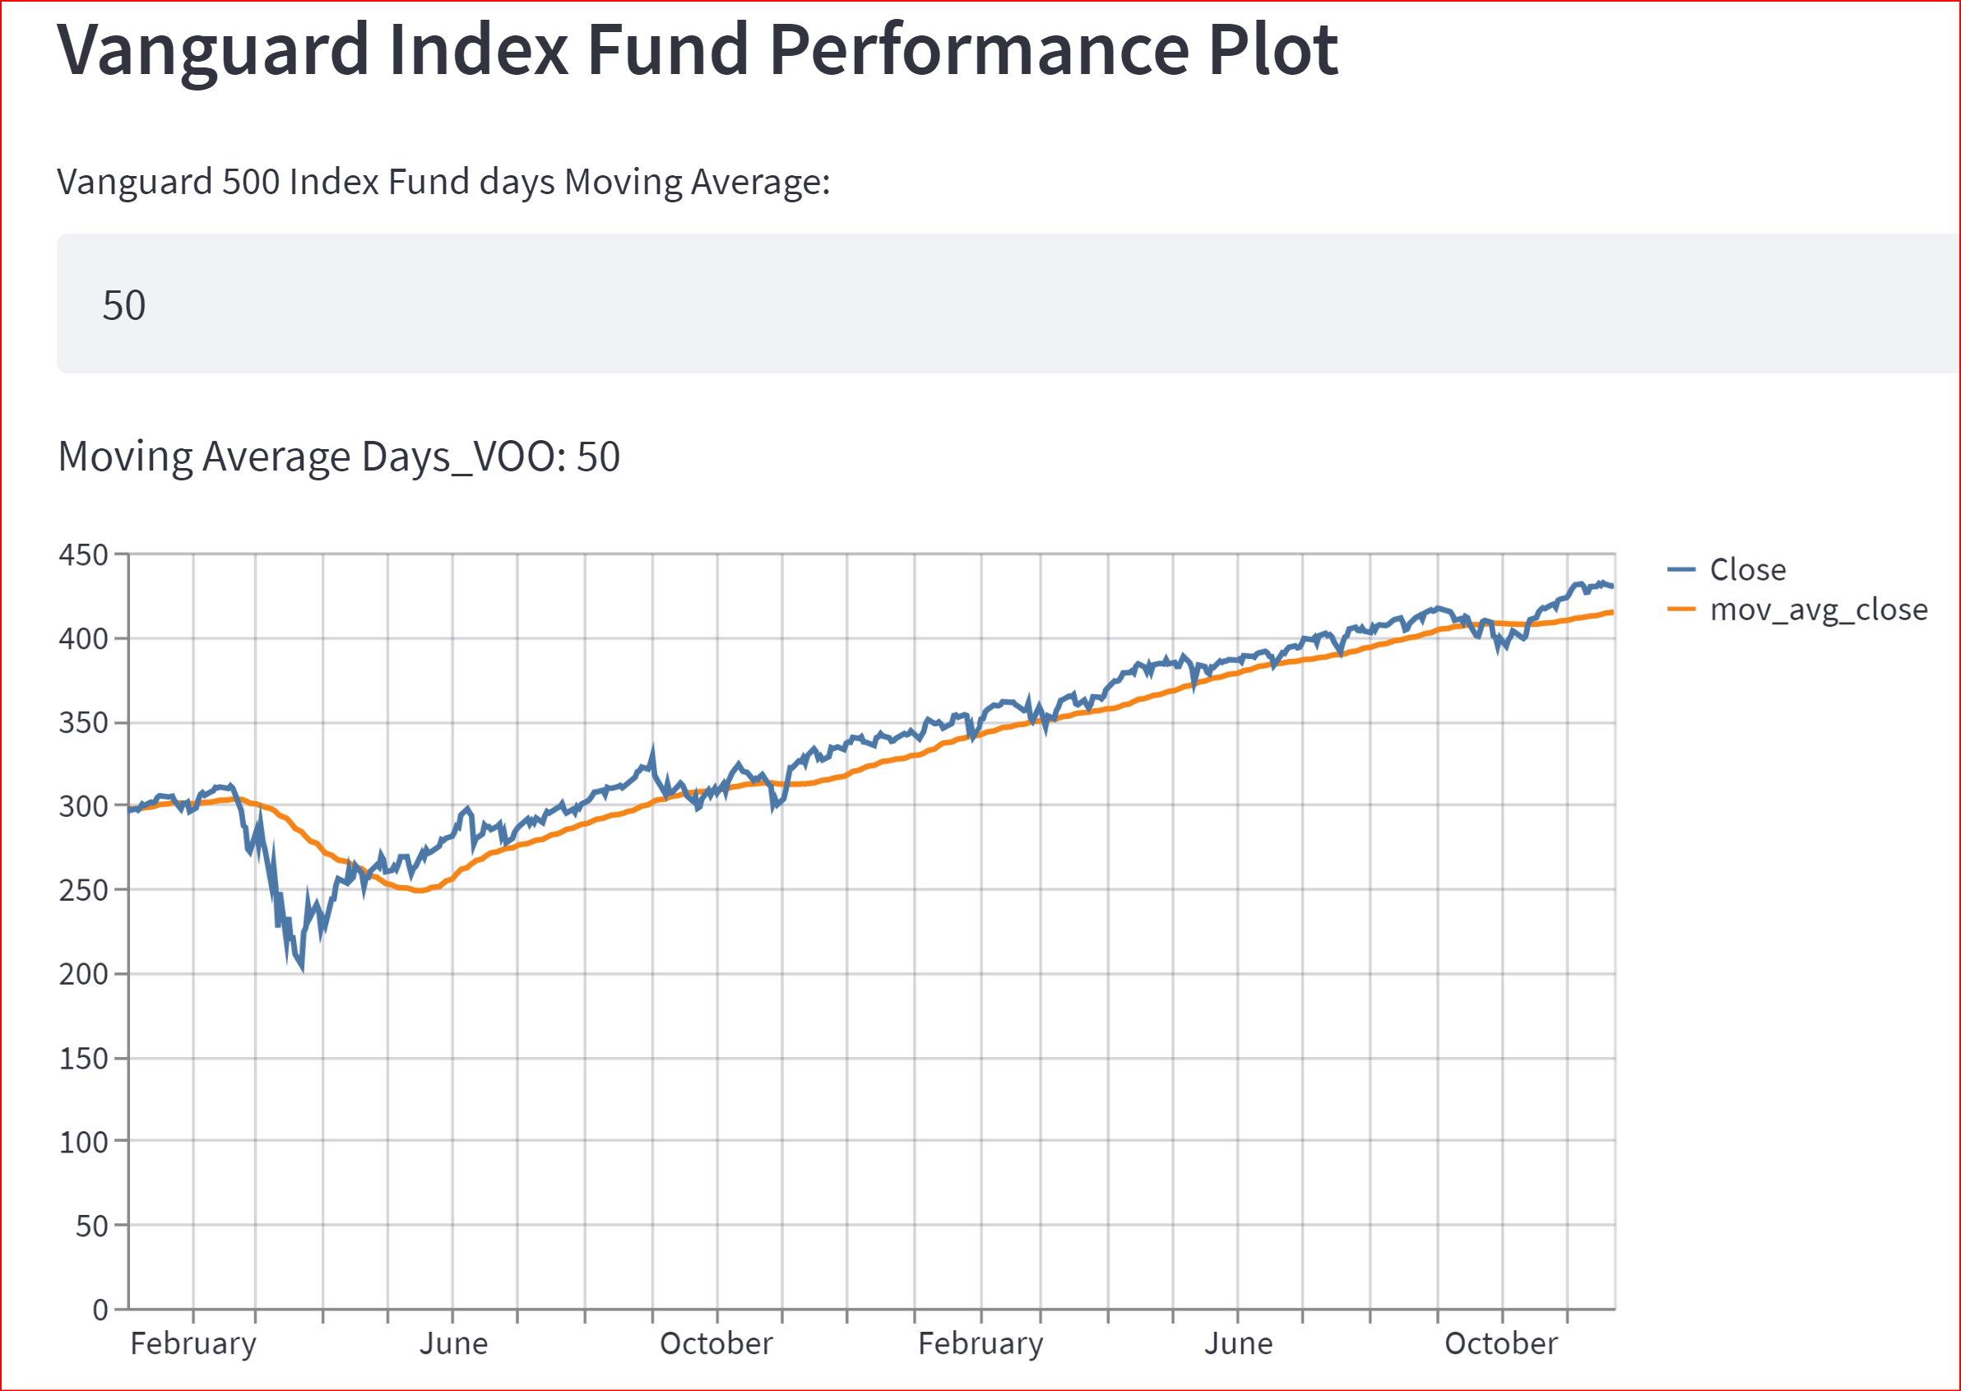
VOO & ETH Performance
The performance of Vanguard 500 Index Fund is made available to the User
A 50 day moving average is shown
The dataframe is generated in Streamlit

Slide 6
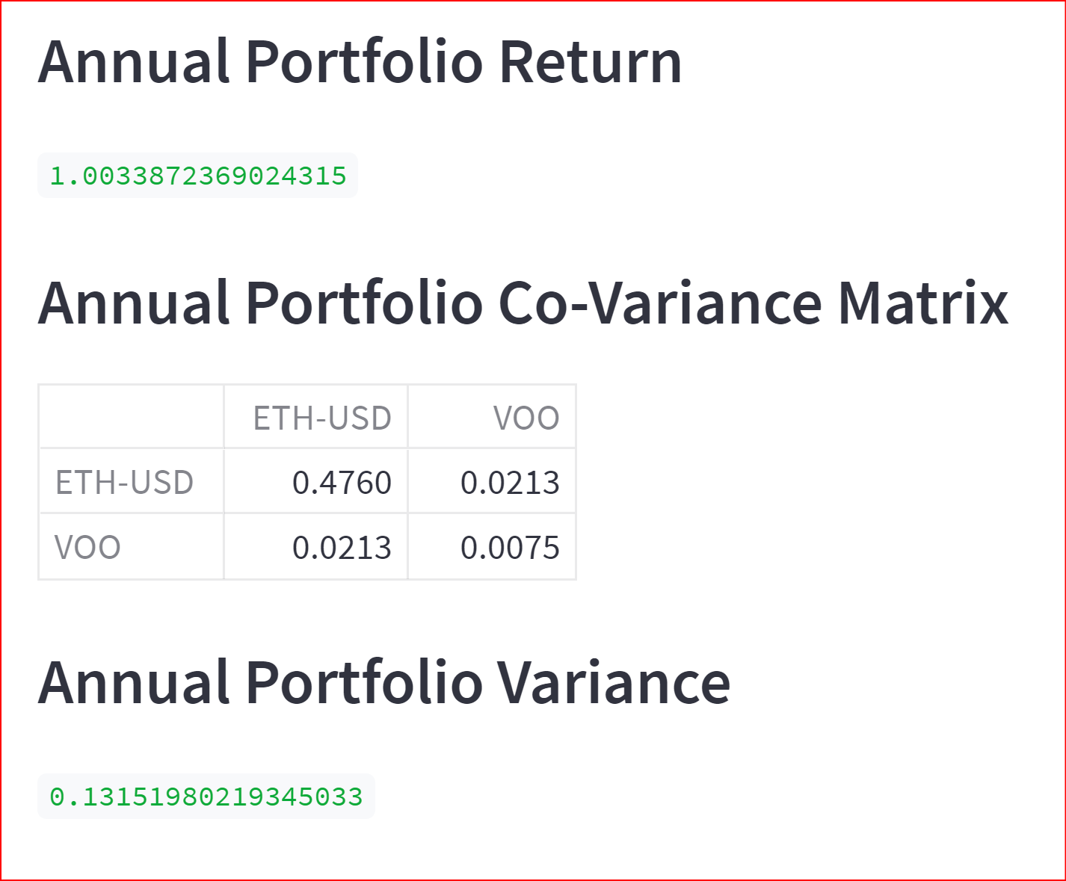
Portfolio Performance
A portfolio split evenly for the number of assets
The outputs will be available to the user on Streamlit if required

Slide 7
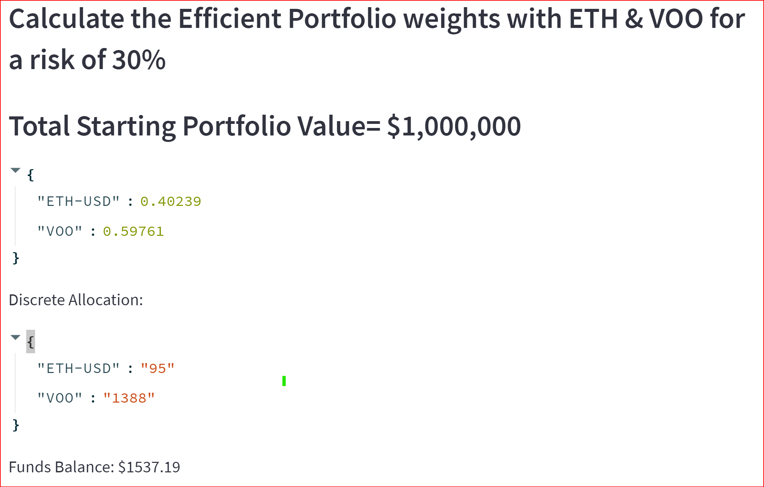
Portfolio Risk
The code calculates an optimized weighting of assets (in this case 2 stocks)
The outputs will be available to the user on Streamlit if required
Can be expanded to any number of assets

Slide 8
Next steps
Python code call smart contracts functions to execute transfer with Solidity code, while allowing the user to have a clean interface with Streamlit
Use code for risk and return measurement, displaying statistics on the Streamlit application before the user executes their decision

